Slide 1
Electric Bicycles in New Jersey

Slide 2
What are electric bicycles?
Any type of bicycle with an integrated electric motor that can be used for propulsion. In some models, the motor does not work without pedaling, while in others the motor can be used exclusively to power the bicycle.
Top speeds vary, up to over 25 mph.
Local and state laws vary. Some e-bikes are classified as bicycles, some as motorcycles, and some as their own e-bike classification.

Slide 3
What are electric bicycles?
Electric Bicycle Classification
Two main types of electric bicycles:
Pedal-assist: motor is engaged only by pedaling and supplements the pedaling rider’s efforts
Power-on-demand: motor is activated by a throttle
Some e-bicycles have both pedal-assist and power-on-demand options

Slide 4
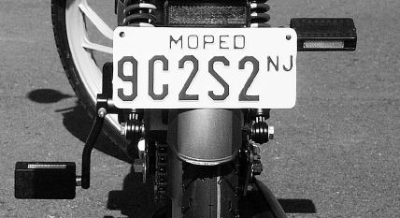
Motorized Bicycles Under NJ Law
A pedal bicycle with a helper motor with cylinder capacity of less than 50 CC AND no more than 1.5 brake horsepower AND has a max speed of no more than 25 mph on the flat
Motorized bicycles/MOPEDs must be titled and registered in New Jersey. Since only MOPEDs approved by the MVC can be registered, and since e-bikes are not approved, they cannot be registered in New Jersey. Effectively, this means that state laws prohibit electric bicycles from being used on public roads.
Thus, there is a grey area regarding electric bicycles . . .
Notes:
(NJDOT Moped Manual, http://www.state.nj.us/mvc/Vehicle/Mopeds.htm)
Throttle Power: refers to the bike operating solely by the engine, without any pedaling.

Slide 5
Automatic Assist (with pedaling)
Throttle Power (without pedaling)
Top speed of 20+ MPH
Range approx. 20 – 45 miles
500W motor
Top speed of ~25 mph
Range approx. 10 miles
600W motor
Top speed of ~ 60mph
Range approx. 85 miles
5,000W motor
Human –powered
Top speed of ~25 mph
No motor
E-Bike
E-Bike
Moped
Bicycle
Notes:
www.wikipedia,org, http://electricbikereview.com/stromer/sport/, http://www.x-tremescooters.com/electric_bicycles/xb562/xb562.html

Slide 6
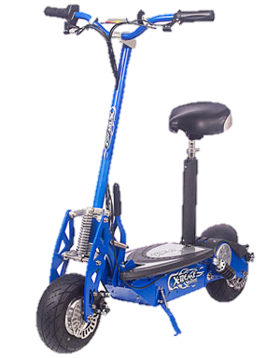
Motorized Scooters Under NJ Law
A miniature motor vehicle and includes scooters, mini-scooters, motorized skateboards and other vehicles not manufactured in compliance with Federal Motor Vehicle Safety Standards and which have no permanent Federal Safety Certification stickers affixed to the vehicle by the original manufacturer. Illegal to drive on public roads or sidewalks.
Specifications
Top speed of ~25 mph
Range approx. 10 miles
600W Motor
Notes:
(http://www.state.nj.us/mvc/Vehicle/Mopeds.htm)
http://www.x-tremescooters.com/electric_scooters/x600/x600.html

Slide 7
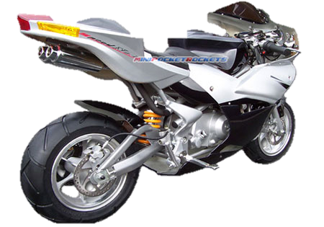
Pocket Bikes Under NJ Law
Small-scale motorcycles with gasoline engines less than 50 CCs that can reach speeds of 45 mph. Pocket bikes are considered toys. Because pocket bikes cannot be titled, insured or registered they cannot be used on public property. However, municipalities now can designate areas where they can be used.
To operate a pocket bike, you must:
Be at least 12 years old
Have liability insurance
Wear a helmet
Register bike with municipality
Notes:
http://www.minipocketrockets.com/110-cc-pocket-bikes/

Slide 8
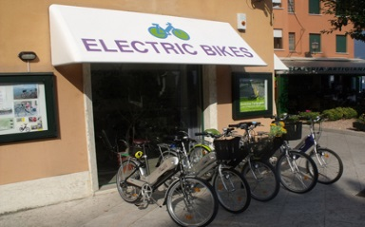
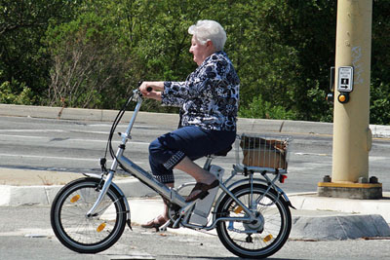
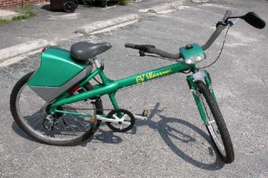
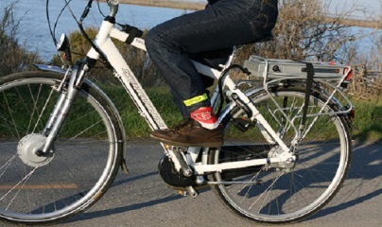
Low-Speed Electric Bicycles Definition Under Federal Law
Two- or three-wheeled vehicle with pedals AND an electric motor with less than 750 watts (1 horsepower) AND with a maximum speed of 20 mph when driven by a 170 pound person. Considered a bicycle, not a motor vehicle.
Commercial e-bikes that exceed these requirements are considered motor vehicles and must meet additional safety requirements. Does not apply to e-bikes assembled by an individual.
Electric bicycles are permitted on federally-funded bicycle or pedestrian paths unless state or local laws prohibit it. The federal definition of an electric bicycle supersedes state laws that are more stringent.
Notes:
HR 727
http://www.law.cornell.edu/uscode/text/15/2085

Slide 9
Low-Speed Electric Bicycles in Other States
New York:
Cannot register the following, or operate them on sidewalks or public streets:
Motor-assisted bicycle: a bicycle that has a small motor attached
Motorized scooter: a scooter with a motor attached
Mini-bike: a small bike with a motor created for off-road use
Dirt bike: similar to a motorcycle but created for off-road use
A MOPED is defined as a low speed vehicle with 2 or 3 wheels – must be registered.
Notes:
http://www.dmv.state.pa.us/pdotforms/fact_sheets/fs-momo.pdf

Slide 10
Low-Speed Electric Bicycles in Other States
Massachusetts:
Motorized Bicycle: a pedal bicycle with an assisting motor, OR a non-pedal bicycle with a motor AND a cylinder capacity not above 50 CC AND an automatic transmission AND a max speed of no more than 30 mph.
Requirements:
May not be operated over 25 mph
Operator must be at least 16 years old
Must register bicycle and have a driver license or learners permit
May use public roads except limited access or express state highways
Must follow road rules specifically for motorized bicycles
May be operated on bike lanes but not off-street recreational paths
Must wear helmet

Slide 11
Problem Statement
Advancements in portable battery technology have enabled bicycle manufacturers to provide electric motors on bicycles that are used to ‘assist’ bicyclists with propulsion. Two types of these bicycles currently exist: Pedal-assist electric bicycles, and Power-on-demand electric bicycles. The former assists a bicyclist in circumstances where it is desired, such as a steep grade or due to fatigue. These bicycles require constant pedaling by the user for the electric motor to remain engaged. The latter can function in the same way, but the important difference is that it can also operate solely through the power of the motor via the use of a throttle, rendering the pedals useless.
Bicycles such as these are currently undefined in the NJ Motor Vehicle Code and can be classified as illegal to use on NJ roads in many circumstances. However, electric bicycles are not illegal to sell in NJ due to consumer protection laws. Due to electric bicycles’ recent addition to the market and their continued increase in popularity, the need to properly define the broad range of vehicles that constitutes an electric bicycle should be a high priority.

